Slide 1
Chi-square
+ practice
18
Probability
and
Statistics
COMS10011
Dr. Anne Roudaut
csxar@bristol.ac.uk
https://github.com/coms10011

Slide 2
scale independent variable
What type of data?
categorical independent variable
scale dependent variable
categorical dependent variable
scale dependent variable
categorical dependent variable
regressions
Logistic
regressions
normally distributed
skewed
2 grp
>2 grp
2 grp
>2 grp
2 grp
>2 grp
Non paired
paired
Non paired
paired
Non paired
paired
Non paired
paired
Counts >= 5 in >= 75% cells
Counts >= 5 in < 75% cells
T-test
ANOVA
Mann-Whitney Utest
Wilcoxon signed rank test
Kruskall-Wallis test
Chi-square test
Fisher’s exact test
Chi-square test
Paired-t-test
Friiedman test
McNemar’s test

Slide 3
until now, we did statistical test using means or medians but the assumptions for means have eliminated certain types of dependant variables (e.g. categories such as gender)
mean not appropriate measure of central tendency for categorical data
Chi-square can do do!

Slide 4
Condition 1
do
or
say
categories
Condition 2
...
measure
Condition n

Slide 5
there are two types of Chi-square tests:
goodness of fit test (for one variable only)
contingency table test (for two variables at a time)

Slide 6
goodness of fit

Slide 7
looks to see if a single variable fits some hypothesised probability distribution
e.g. in a population of students, there is an equal number of students who like or dislike brussels sprouts
in fact we don’t even have to go 50/50, we may theorize only 25% will like them (because they are disgusting!)

Slide 8
# of persons
like BP 11
Dislike BP 139
150 (total)

Slide 9
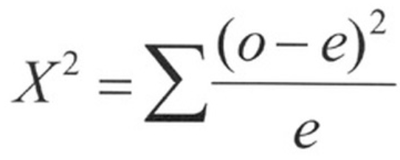
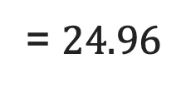
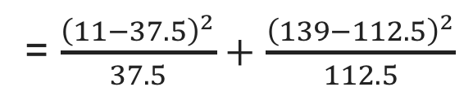
# of persons %expected # expected
like BP 11 25% 37.5 (25% of 150)
Dislike BP 139 75% 112.5 (75% of 150)
150 (total) 100% 150 (total)
observed cases
expected cases
= $\frac{{\left(11−37.5\right)}^{2}}{37.5}+$ $\frac{{\left(139−112.5\right)}^{2}}{112.5}$
= $24.96$

Slide 10
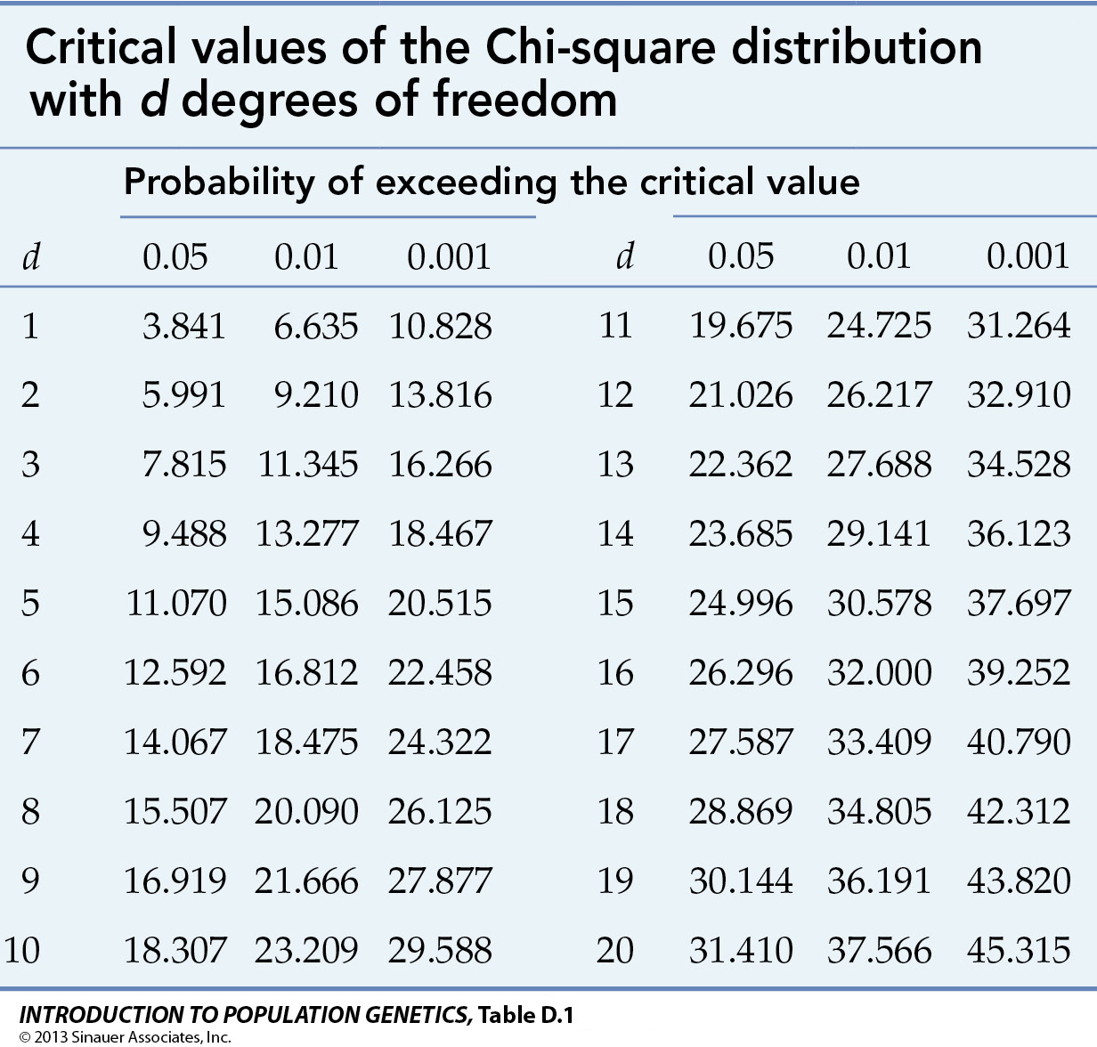
now, like with all the test we have seen, we look into a table, here the Chi-square table)
degree of freedom DF
= number of group - 1

Slide 11
24.96 > 3.841 so we reject the null hypothesis
our theory of 25% Brussel Sprout lovers does not hold

Slide 12
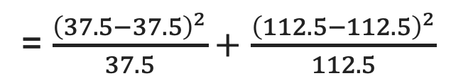
# of persons %expected # expected
like BP 37.5 25% 37.5 (25% of 150)
Dislike BP 112.5 75% 112.5 (75% of 150)
150 (total) 100% 150 (total)
observed cases
expected cases
= $\frac{{\left(37.5−37.5\right)}^{2}}{37.5}+$ $\frac{{\left(112.5−112.5\right)}^{2}}{112.5}$
= 0

Slide 13
let’s see if our theory holds with a raise of hand
who like Brussel sprout?
who dislike Brussel sprout?

Slide 14
R
table = c(13,69)
chisq.test(table, p = c(1/4, 3/4))
Chi-squared test for given probabilities
data: table
X-squared = 24.969, df = 1, p-value = 5.826e-07
if p<0.05 reject null, not good model

Slide 15
this example is fairly simple but Chi-square also work with more data, e.g. 30% prefer eating chicken for Christmas dinner, 50% prefer turkey, 10% prefer vegetarian option, 10% prefer other types of meat

Slide 16
R
table = c(30,50,20,10)
chisq.test(table, p = c(0.3,0.5,0.1,0.1))
Chi-squared test for given probabilities
data: table
X-squared = 8.1818, df = 3, p-value = 0.0424
(still reject, not good model)

Slide 17
contingency tables

Slide 18
public opinion surveys tend to show relationship between gender and something, e.g. preference in sport car vs. family car (public opinion surveys are very stereotypical!)
so here we have two variables: gender (female or male) and car preference (sport or family)
we do a Chi-square contingency table test to prove preference of car is related to or dependant upon gender
male female
sport 26 3
family 24 22

Slide 19
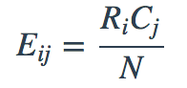
but we don’t have ”expected value” here so we first need to calculate them for each cell
where R = row, C= column, N = total,
for ith row and jth column

Slide 20
male female Sum
sport 26 3 29
family 24 22 46
Sum 50 25 75
1. we compute the sums in all direction
2. for each cell, multiplying that cells row and column totals and dividing by our total sample size
e.g. case (sport, male)= (29 * 50) / 75
e.g. case (family, male= (46 * 50) / 75
…

Slide 21
Obs. male female
sport 26 3
family 24 22
Exp. male female
sport 19.3 0.9
family 30.6 15.3
4. use same Chi-square formula than before
5. Calculate degree of freedom as DF =(number of rows−1)∗(number of columns−1) (here = 1)
6. Use the Chi-square table to conclude!
Notes:
pchisq(0.43, df=2, lower.tail = FALSE)

Slide 22
R
table = matrix(c(26, 24, 3, 22), ncol=2)
colnames(table) = c('male', 'female')
rownames(table) = c('sport','family’)
addmargins(table)
male female Sum
sport 26 3 29
family 24 22 46
Sum 50 25 75
chisq.test(table,correct=FALSE) #must use correct=FALSE for a 2 by 2 table otherwise = TRUE
Pearson's Chi-squared test
data: table
X-squared = 11.244, df = 1, p-value = 0.0007986

Slide 23
we reject the null and conclude that car type preference is dependant of gender

Slide 24
extra R

Slide 25
2 grp
>2 grp
Non paired
paired
Counts >= 5 in >= 75% cells
Counts >= 5 in < 75% cells
Chi-square test
Fisher’s exact test
Chi-square test
McNemar’s test

Slide 26
R
Fisher
> library(MASS) # load the MASS package > tbl = table(survey$Smoke, survey$Exer)
> tbl # the contingency table Freq None Some Heavy 7 1 3 Never 87 18 84 Occas 12 3 4 Regul 9 1 7
fisher.test(tbl) # if Counts >= 5 in < 75% cells otherwise or chisq.test(tbl)
Fisher's Exact Test for Count Data
data: tbl
p-value = 0.4138
alternative hypothesis: two.sided
Notes:
head(cars) # cars is a table that already comes with R and contain 50 observations of speed and distance in two rows
scatter.smooth(x=cars$speed, y=cars$dist, main="Dist ~ Speed") # scatterplot
linearMod <- lm(dist ~ speed, data=cars) # build linear regression model on full data
summary(linearMod) # summary(linearMod)$r.squared
abline(linearMod, col="blue")

Slide 27
R
mcnemar
# mcnemar example on presidential Approval Ratings: Approval of the President's performance in office in two surveys, one month apart, for a random sample of 1600 voting-age Americans.
Performance <- matrix(c(794, 86, 150, 570), nrow = 2, dimnames = list("1st Survey" = c("Approve", "Disapprove"), "2nd Survey" = c("Approve", "Disapprove")))
Performance
2nd Survey
1st Survey Approve Disapprove
Approve 794 150
Disapprove 86 570
mcnemar.test(Performance)
Notes:
head(cars) # cars is a table that already comes with R and contain 50 observations of speed and distance in two rows
scatter.smooth(x=cars$speed, y=cars$dist, main="Dist ~ Speed") # scatterplot
linearMod <- lm(dist ~ speed, data=cars) # build linear regression model on full data
summary(linearMod) # summary(linearMod)$r.squared
abline(linearMod, col="blue")

Slide 28
pre-summary

Slide 29
ok so now you know almost all the tests needed!

Slide 30
scale independent variable
What type of data?
categorical independent variable
scale dependent variable
categorical dependent variable
scale dependent variable
categorical dependent variable
regressions
Logistic
regressions
normally distributed
skewed
2 grp
>2 grp
2 grp
>2 grp
2 grp
>2 grp
Non paired
paired
Non paired
paired
Non paired
paired
Non paired
paired
Counts >= 5 in >= 75% cells
Counts >= 5 in < 75% cells
T-test
ANOVA
Mann-Whitney Utest
Wilcoxon signed rank test
Kruskall-Wallis test
Chi-square test
Fisher’s exact test
Chi-square test
Paired-t-test
Friiedman test
McNemar’s test

Slide 31
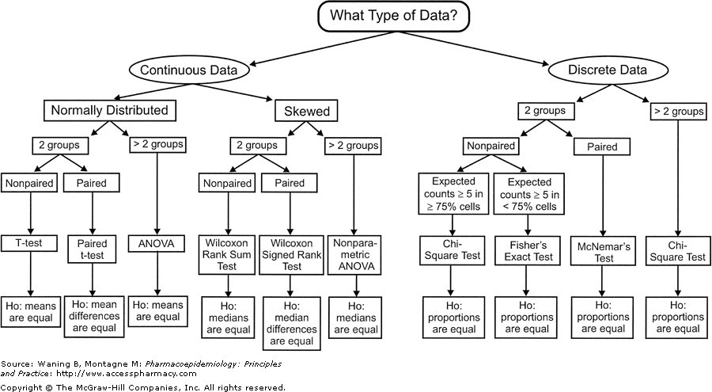
scale independent variable
What type of data?
categorical independent variable
scale dependent variable
categorical dependent variable
scale dependent variable
categorical dependent variable
regressions
logistic
regressions
normally distributed
skewed
2 grp
>2 grp
2 grp
>2 grp
2 grp
>2 grp
Non paired
paired
Non paired
paired
Non paired
paired
Non paired
paired
Counts >= 5 in >= 75% cells
Counts >= 5 in < 75% cells
T-test
ANOVA
Mann-Whitney Utest
Wilcoxon signed rank test
Kruskall-Wallis test
Chi-square test
Fisher’s exact test
Chi-square test
Paired-t-test
Friiedman test
McNemar’s test

Slide 32
the most important is not that you do these by hands but that you understand the intuition behind them and more importantly when to use them

Slide 33
recognizing data types

Slide 35


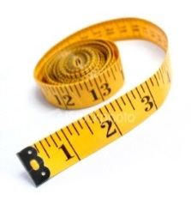


Slide 36
Q1: What is your favourite subject?
Q2: Gender:
Q3: Score in a recent mock GCSE maths exam
Q4: I consider myself to be good at mathematics:
Maths | English | Science | Art | French
Male | Female
Score between 0% and 100%
Strongly Disagree | Disagree | Not Sure | Agree | Strongly Agree

Slide 37
Categorical / Nominal
Q1: What is your favourite subject?
Q2: Gender:
Q3: Score in a recent mock GCSE maths exam
Q4: I consider myself to be good at mathematics:
Maths | English | Science | Art | French
Categorical / Nominal (binary)
Male | Female
Score between 0% and 100%
Scale
Strongly Disagree | Disagree | Not Sure | Agree | Strongly Agree
Categorical / Ordinal but special case = continuous!

Slide 38
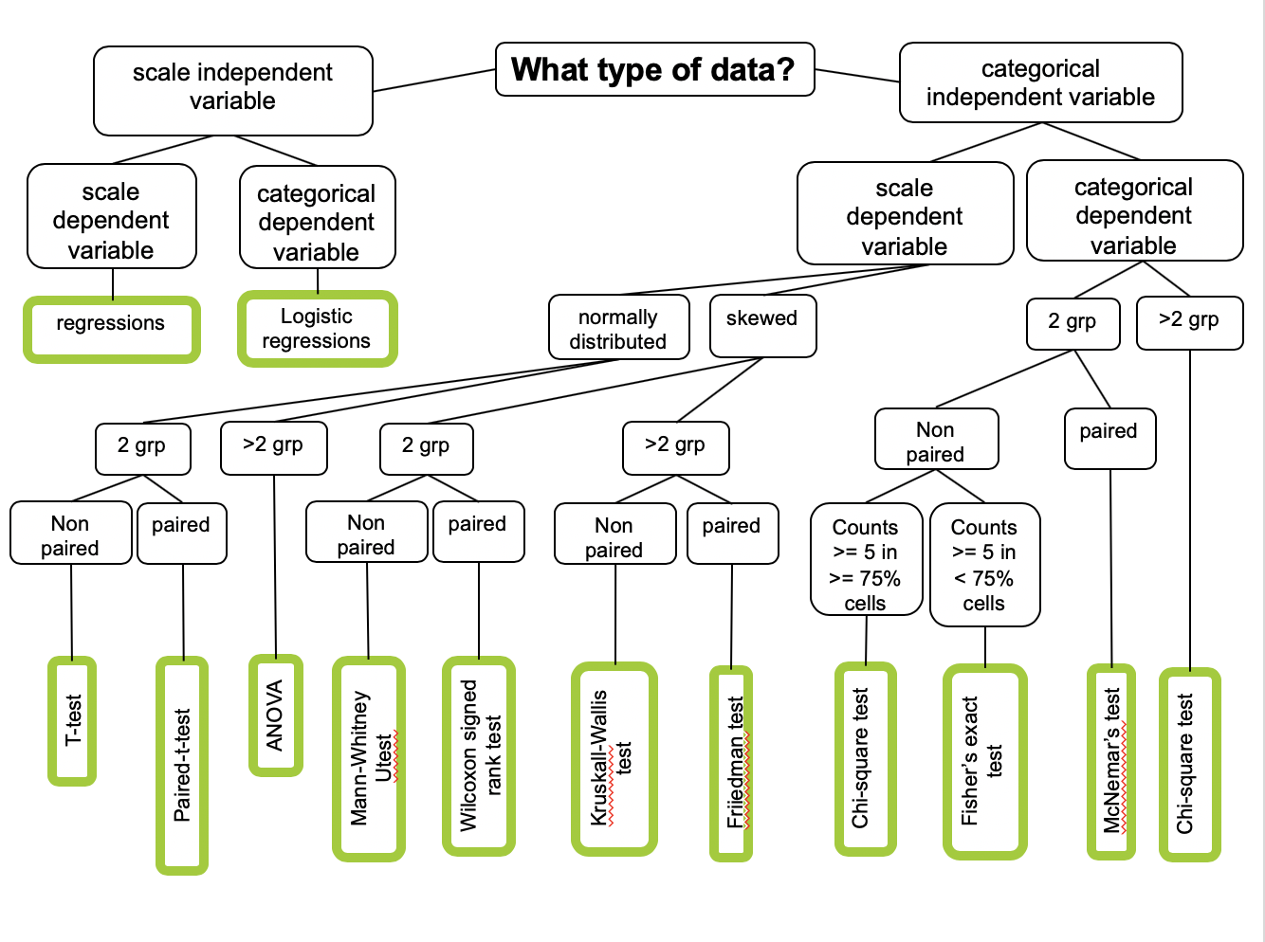
Likert can be treated as continuous

Slide 39
navigating the graph

Slide 40
Condition 1
Metrics (most
often only 1)
Condition 2
...
measure
Condition n
do

Slide 41
nature of this
(independent variables)
Condition 1
nature of this
(dependent ones)
Metrics (most
often only 1)
Condition 2
...
measure
Condition n
do

Slide 42
scale independent variable
What type of data?
categorical independent variable
Condition 1
Scale IV?
Or categorical IV?
Size of targets users point at
Weight of users
Amount of chocolate eaten
Condition 2
...
Chocolate vs. not vs. punishment
Condition n
Gender
Milk before or after
do

Slide 43
scale independent variable
What type of data?
caterorical independent variable
Condition 1
Scale IV?
Or categorical IV?
Size of targets users point at
Weight of users
Amount of chocolate eaten
Condition 2
...
Chocolate vs. not vs. punishment
Condition n
Gender
Milk before or after
do

Slide 44
scale independent variable
What type of data?
categorical independent variable
scale dependent variable
categorical dependent variable
regressions
Logistic
regressions

Slide 45
scale independent variable
What type of data?
categorical independent variable
Condition 1
Scale IV?
Or categorical IV?
Size of targets users point at
Weight of users
Amount of chocolate eaten
Condition 2
...
Chocolate vs. not vs. punishment
Condition n
Gender
Milk before or after
do

Slide 46
scale independent variable
What type of data?
categorical independent variable
scale dependent variable
categorical dependent variable

Slide 47
scale independent variable
What type of data?
categorical independent variable
scale dependent variable
categorical dependent variable
Metrics (most
often only 1)
measure

Slide 48
scale independent variable
What type of data?
categorical independent variable
scale dependent variable
categorical dependent variable
Scale DV?
Or categorical DV?
Memorization score
Metrics (most
often only 1)
Time or errors
Liker scale answers (special case!)
measure
Yes No answer
Preference between X categories
Gender

Slide 49
scale independent variable
What type of data?
categorical independent variable
scale dependent variable
categorical dependent variable
Scale DV?
Or categorical DV?
Memorization score
Metrics (most
often only 1)
Time or errors
Liker scale answers (special case!)
measure
Yes No answer
Preference between X categories
Gender

Slide 50
scale independent variable
What type of data?
categorical independent variable
scale dependent variable
categorical dependent variable
2 grp
>2 grp
Non paired
paired
Counts >= 5 in >= 75% cells
Counts >= 5 in < 75% cells
Chi-square test
Fisher’s exact test
Chi-square test
McNemar’s test

Slide 51
scale independent variable
What type of data?
categorical independent variable
scale dependent variable
categorical dependent variable
Scale DV?
Or categorical DV?
Memorization score
Metrics (most
often only 1)
Time or errors
Liker scale answers (special case!)
measure
Yes No answer
Preference between X categories
Gender

Slide 52
scale independent variable
What type of data?
categorical independent variable
scale dependent variable
categorical dependent variable
normally distributed
skewed
2 grp
>2 grp
2 grp
>2 grp
Non paired
paired
Non paired
paired
Non paired
paired
T-test
ANOVA
Mann-Whitney Utest
Wilcoxon signed rank test
Kruskall-Wallis test
Paired-t-test
Friiedman test

Slide 53
scale independent variable
What type of data?
categorical independent variable
scale dependent variable
categorical dependent variable
scale dependent variable
categorical dependent variable
regressions
Logistic
regressions
normally distributed
skewed
2 grp
>2 grp
2 grp
>2 grp
2 grp
>2 grp
Non paired
paired
Non paired
paired
Non paired
paired
Non paired
paired
Counts >= 5 in >= 75% cells
Counts >= 5 in < 75% cells
T-test
ANOVA
Mann-Whitney Utest
Wilcoxon signed rank test
Kruskall-Wallis test
Chi-square test
Fisher’s exact test
Chi-square test
Paired-t-test
Friiedman test
McNemar’s test

Slide 54
summary

Slide 55
take away
Be able to give the CHI-square formula (goodness of fit and contingency table)
Calculate a CHI-square by hand on an example with a single variable and conclude
Explain what is the different between goodness of fit and contingency table methods
Be able to navigate the mother of all stats graph! = know how to identify a variable type and choose appropriate test

Slide 56
take away
in the exam the only calculations I could make you do are linear regression or chi square
you don’t need to learn the formula for all the other statistic tests

Slide 57
unit menu
Linear regression
Hypothesis testing, comparing things
Experimental design part 1
Experimental design part 2
T-test and ANOVA
Pre-requisite to ANOVA
Non-parametric tests
Categorical data: Chi-square
Sample size, power and effect size (guest)
P-hacking and alternatives tests (guest)

Slide 58
end

Slide 59
anova bis

Slide 60
imagine you are a maze designer

Slide 61
want to design a maze harder than ever and produced those 4:
you get some 16 participants to run each of them (within design) and measure time taken to escape
(of course making sure you counterbalanced the order of the maze)

Slide 62
time to escape
this is what you get (mean time)

Slide 63
R
# Find the mean of each group
library(plyr)
dat = read.csv("anovamaze.csv", header = TRUE)
cdat <- ddply(dat, "maze", summarise, time.mean=mean(time))
cdat
maze time.mean
1 a 15.08056
2 b 50.26166
3 c 30.38068
4 d 29.61912

Slide 64
let’s assume normality of the data and homogeneity of variance
so you have one independent variable which is the type of maze, this independent variable has 4 groups:
we have more than two groups, so we either:
option 1: t-test with Bonferroni correction
option 2: Anova (or also called one-way Anova)

Slide 65
R
# first we run the one-way anova
library(ez) #install.packages("ez")
ezANOVA(dat,id,within=maze,dv=time)
$ANOVA
Effect DFn DFd F p p<.05 ges
2 maze 3 45 6.524565 0.0009277126 * 0.2607015
Tell us something is going
to be significant but don’t know yet what
Notes:
head(cars) # cars is a table that already comes with R and contain 50 observations of speed and distance in two rows
scatter.smooth(x=cars$speed, y=cars$dist, main="Dist ~ Speed") # scatterplot
linearMod <- lm(dist ~ speed, data=cars) # build linear regression model on full data
summary(linearMod) # summary(linearMod)$r.squared
abline(linearMod, col="blue")

Slide 66
R
# second, run the pairwise comparison
pairwise.t.test(dat$time,dat$maze, paired=TRUE, p.adjust.method="bonferroni")
a b c
b 0.015 - -
c 0.015 0.375 -
d 0.076 0.365 1.000
everything <0.05 = significant (no need to do the Bonferroni correction as already included)
the test literally allows us to “compare” a and b as well as a and c and that is it!
Notes:
head(cars) # cars is a table that already comes with R and contain 50 observations of speed and distance in two rows
scatter.smooth(x=cars$speed, y=cars$dist, main="Dist ~ Speed") # scatterplot
linearMod <- lm(dist ~ speed, data=cars) # build linear regression model on full data
summary(linearMod) # summary(linearMod)$r.squared
abline(linearMod, col="blue")

Slide 67
comparable
time to escape
A better than B
A better than C

Slide 68
you are still a maze designer

Slide 69
same mazes to compare but you also want to try if placing an ice cream van at the exit improve performance
let say we keep the results from our 16 first participants from earlier (no ice cream at the end)
we take 16 new participants to do each mazes but this time with ice cream at the end
maze variable is within (paired) and ice cream variable is between (unpaired)

Slide 70
let’s assume normality of the data and homogeneity of variance
so you have two independent variables, one which has 4 groups: and one which has 2:
we need a two-way Anova

Slide 71
R
# Find the mean of each group
library(plyr)
dat = read.csv("anovamaze 2.csv", header = TRUE)
cdat <- ddply(dat, "maze", summarise, time.mean=mean(time))
cdat
maze time.mean
1 a 14.20556
2 b 49.26166
3 c 29.44318
4 d 28.68162
cdat <- ddply(dat, "icecream", summarise, time.mean=mean(time))
cdat
icecream time.mean
1 no 29.4605
2 yes 31.3355
Notes:
head(cars) # cars is a table that already comes with R and contain 50 observations of speed and distance in two rows
scatter.smooth(x=cars$speed, y=cars$dist, main="Dist ~ Speed") # scatterplot
linearMod <- lm(dist ~ speed, data=cars) # build linear regression model on full data
summary(linearMod) # summary(linearMod)$r.squared
abline(linearMod, col="blue")

Slide 72
R
# first we run the one-way anova
library(ez) #install.packages("ez")
ezANOVA(dat,id,within=maze,between=icecream,dv=time)
$ANOVA
Effect DFn DFd F p p<.05 ges
2 icecream 1 30 3.153983e-01 5.785581e-01 1.987341e-03
3 maze 3 90 1.303667e+01 3.815230e-07 * 2.604904e-01
4 icecream:maze 3 90 1.637732e-04 9.999971e-01 4.425088e-06
1
2
3
each is <0.05 (3 effects) so we know something is going to be significant but don’t know yet what
Notes:
head(cars) # cars is a table that already comes with R and contain 50 observations of speed and distance in two rows
scatter.smooth(x=cars$speed, y=cars$dist, main="Dist ~ Speed") # scatterplot
linearMod <- lm(dist ~ speed, data=cars) # build linear regression model on full data
summary(linearMod) # summary(linearMod)$r.squared
abline(linearMod, col="blue")

Slide 73
R
#run the pairwise comparison
pairwise.t.test(dat$time,dat$icecream, paired=TRUE, p.adjust.method="bonferroni")
no
yes <2e-16
everything <0.05 = significant (no need to do the Bonferroni correction as already included)
1
effect on ice cream: the test literally allows us to “compare” ice cream vs. no ice cream
Notes:
head(cars) # cars is a table that already comes with R and contain 50 observations of speed and distance in two rows
scatter.smooth(x=cars$speed, y=cars$dist, main="Dist ~ Speed") # scatterplot
linearMod <- lm(dist ~ speed, data=cars) # build linear regression model on full data
summary(linearMod) # summary(linearMod)$r.squared
abline(linearMod, col="blue")

Slide 74
comparable = having ice cream improve performance
time to escape

Slide 75
R
# second, run the pairwise comparison
pairwise.t.test(dat$time,dat$maze, paired=TRUE, p.adjust.method="bonferroni")
a b c
b 7.4e-05 - -
c 5.8e-05 0.0427 -
d 0.0017 0.0400 1.0000
everything <0.05 = significant (no need to do the Bonferroni correction as already included)
2
effect on maze: the test literally allows us to “compare” everything except d vs. c
Notes:
head(cars) # cars is a table that already comes with R and contain 50 observations of speed and distance in two rows
scatter.smooth(x=cars$speed, y=cars$dist, main="Dist ~ Speed") # scatterplot
linearMod <- lm(dist ~ speed, data=cars) # build linear regression model on full data
summary(linearMod) # summary(linearMod)$r.squared
abline(linearMod, col="blue")

Slide 76
all comparable but this
time to escape
Worst
Best!

Slide 77
R
# first we run the one-way anova
library(ez) #install.packages("ez")
ezANOVA(dat,id,within=maze,between=icecream,dv=time)
$ANOVA
Effect DFn DFd F p p<.05 ges
2 icecream 1 30 3.153983e-01 5.785581e-01 1.987341e-03
3 maze 3 90 1.303667e+01 3.815230e-07 * 2.604904e-01
4 icecream:maze 3 90 1.637732e-04 9.999971e-01 4.425088e-06
last one is what we call “interaction”
3
effect on interaction

Slide 78
R
# second, run the pairwise comparison only if
dat_ice = subset(dat, icecream == "yes")
pairwise.t.test(dat_ice$time, dat_ice$maze, paired=TRUE, p.adjust.method="bonferroni")
a b c
b 0.015 - -
c 0.015 0.375 -
d 0.076 0.365 1.000
dat_noice = subset(dat,icecream == "no")
pairwise.t.test(dat_noice$time, dat_noice$maze, paired=TRUE, p.adjust.method="bonferroni")
a b c
b 0.015 - -
c 0.013 0.385 -
d 0.073 0.370 1.000
everything <0.05 = significant (no need to do the Bonferroni correction as already included)
everything <0.05 = significant (no need to do the Bonferroni correction as already included)

Slide 79
R
# second, run the pairwise comparison
library(tidyverse)
datmale = read_csv("anovamaze 2.csv") %>% filter(`gender`== "male")
datfemale = read_csv("anovamaze 2.csv") %>% filter(`gender`== "female")
pairwise.t.test(datmale$time,datmale$group, paired=TRUE, p.adjust.method="bonferroni")
b 0.015 - -
c 0.015 0.375 -
d 0.076 0.365 1.000
pairwise.t.test(datfemale$time,datfemale$group, paired=TRUE, p.adjust.method="bonferroni")
a b c
b 0.015 - -
c 0.013 0.385 -
d 0.073 0.370 1.000

Slide 80
density and sampling distribution

Slide 81
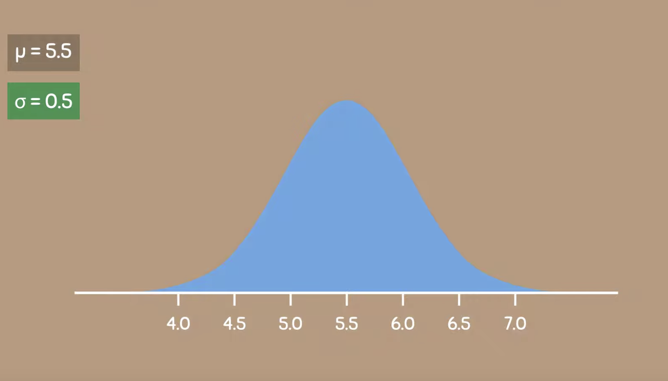
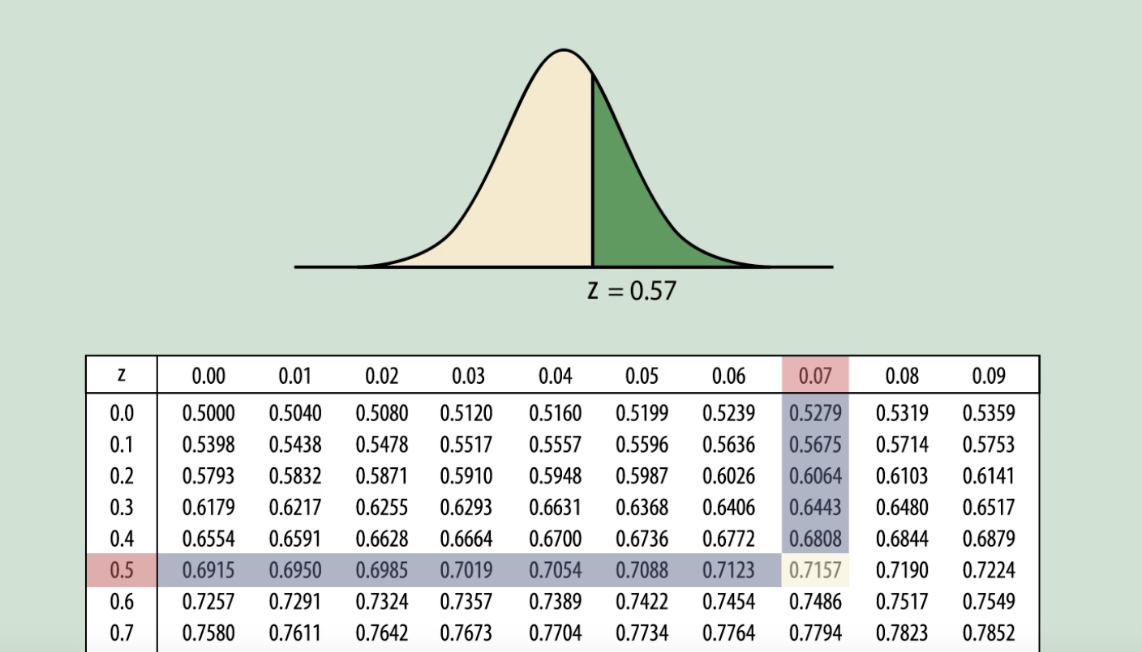
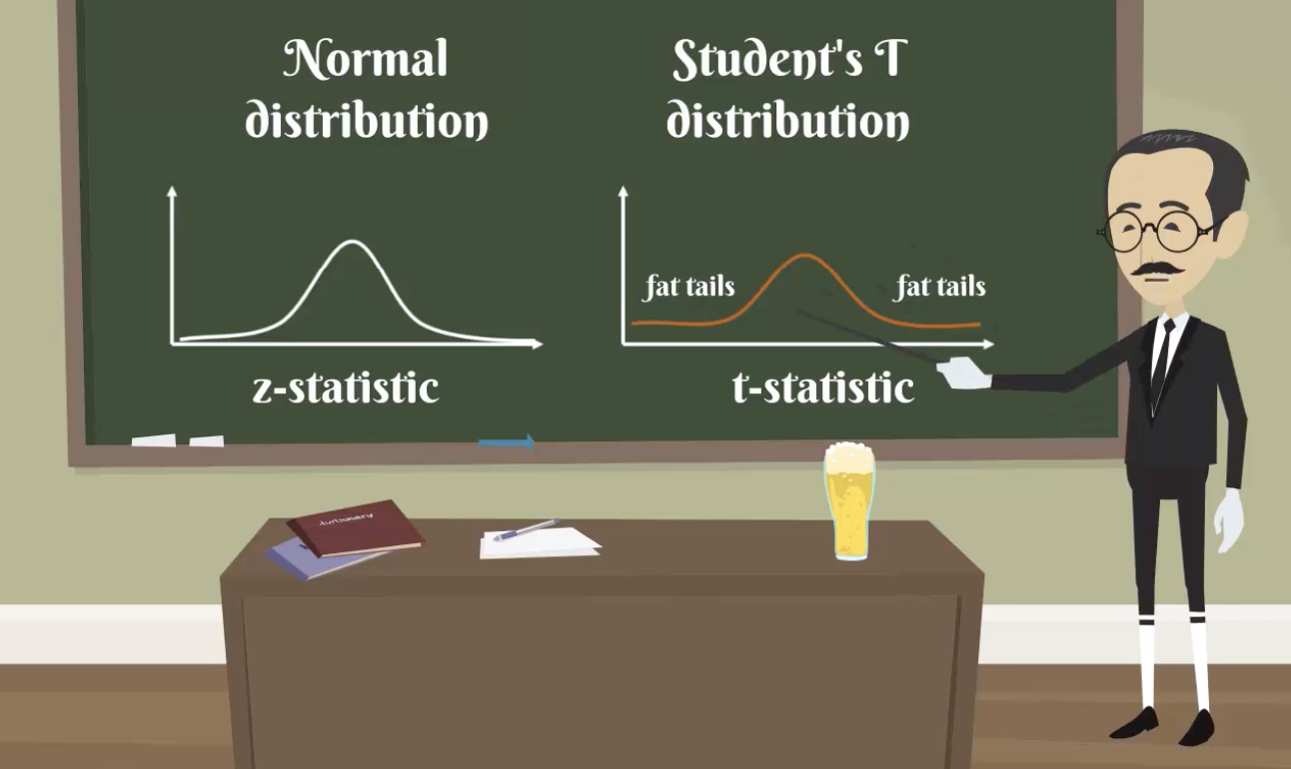
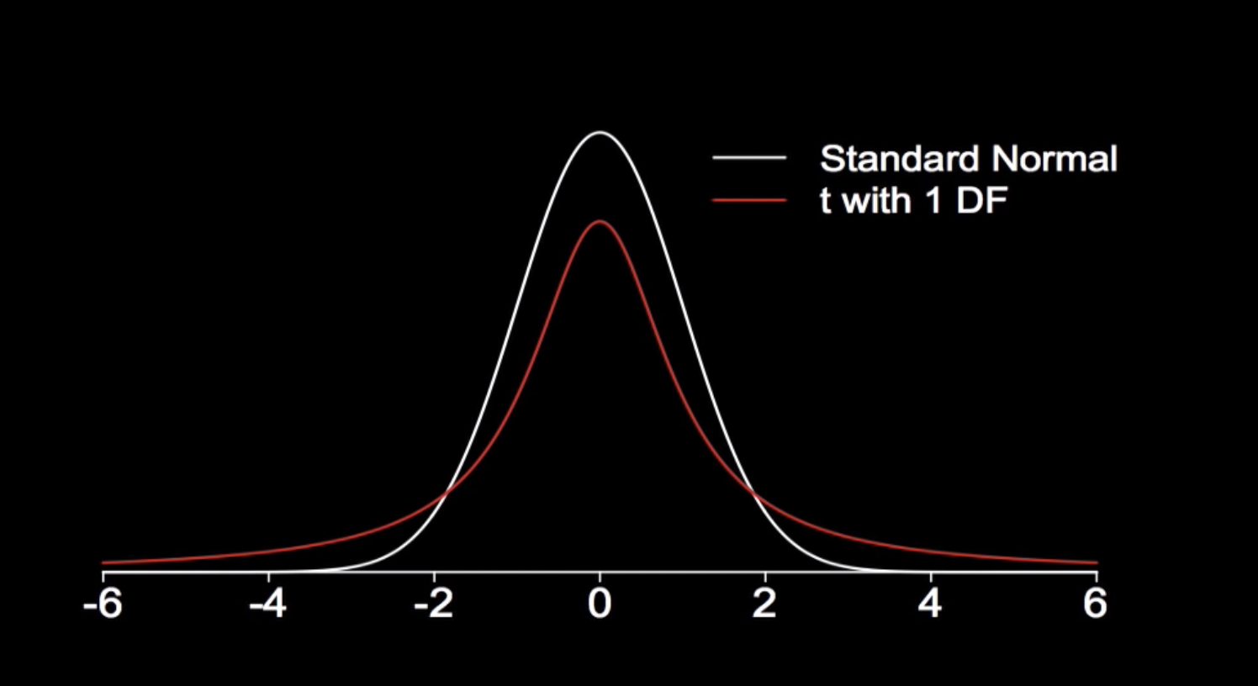
Normal Distribution
https://www.youtube.com/watch?v=mtbJbDwqWLE
Zscore
https://www.youtube.com/watch?v=2tuBREK_mgE
Student T test
https://www.youtube.com/watch?v=32CuxWdOlow
T distribution
https://www.youtube.com/watch?v=Uv6nGIgZMVw

Slide 82
end

